Slide 1



The Battle of the Neighborhoods

Slide 2
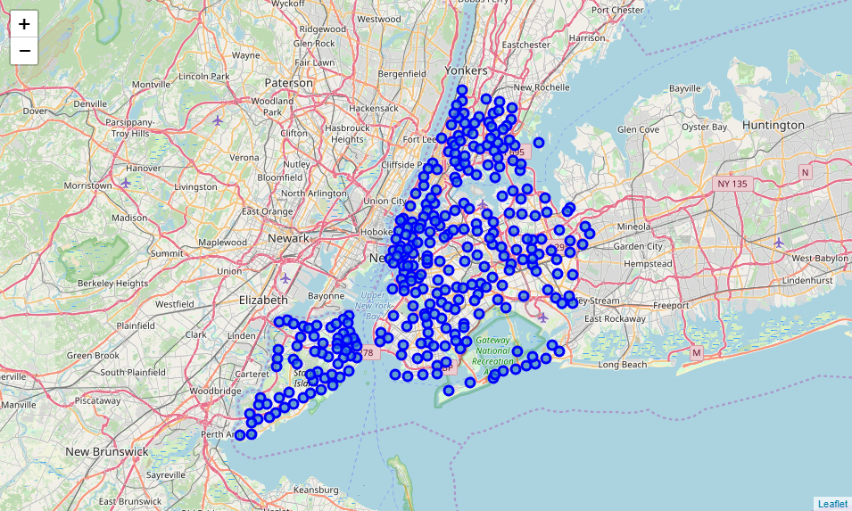
Introduction
This report focuses on Queens, New York city. Bars are common in this city and can be considered as money making business. New York is one of the busiest and progressive cities in the world. Bars are always filled with people. this report will target the best places to put up Bars for business.

Slide 3
Data
Business Problem
Determine the best up to date places in New York, Queens. This report will give small and big entrepreneurs ideas and suggestions where to start up a Bar.
The following data will be use int his report:
New York neighborhoods dataset.
Neighborhood coordinates in Queens, New York.
Foursquare API for data related to Queens, New York.

Slide 4
Methodology
Focusing on Queens, New York. Once the data stated in the data sections has been collected, create the necessary data frames to use for analysis as well as the required libraries to apply different analysis in Python. Most of the analysis was focused on location data, such as the neighborhoods, boroughs, and their corresponding coordinates. Because the aim is to identify the best places to startup a bar business, the location data and the Foursquare API are very useful. Clustering, K-Means, are very helpful in this analysis. Integrating Foursquare API makes the results even more understandable.

Slide 5
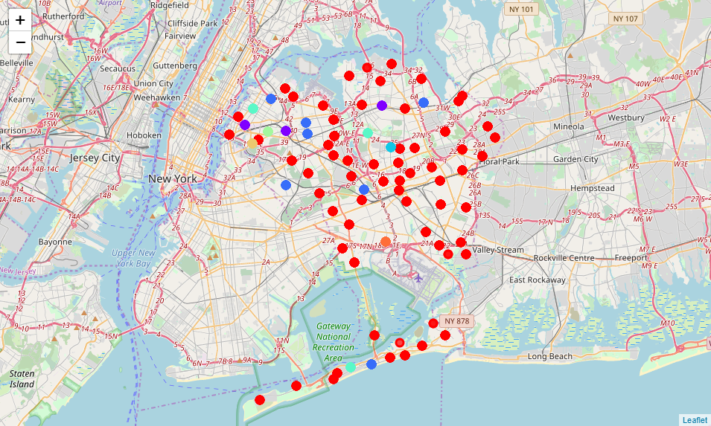
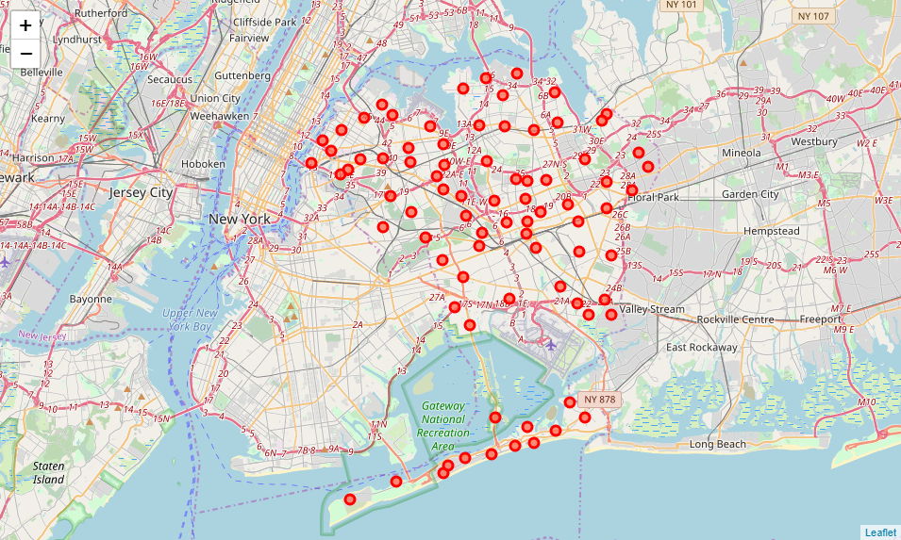
Data Process and Model
K-Means clustering is used to group the venues. Unsupervised, simple and easy to use. Eight clusters are made to narrow down the areas, and easily identify the best venues.

Slide 6
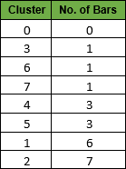
Results and Observations
The table below shows the number of Bars in each cluster. Cluster 0 is the most promising. It has the greatest number of neighborhoods.
Cluster’s 1 and 2 are the ones with most numbers of Bars already. Clusters 3, 6, and 7 are also good choice to start up a business.

Slide 7
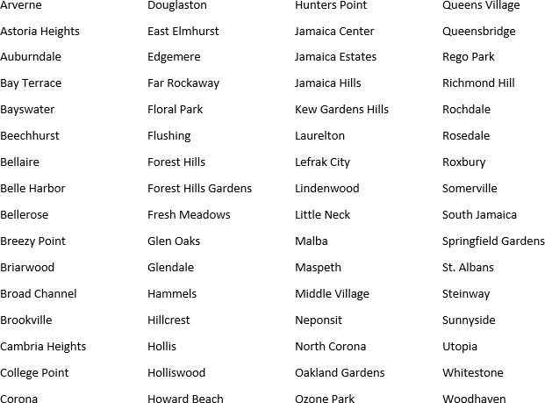
Results and Observations
Neighborhoods with best potential:

Slide 8
Conclusion
Using variety of techniques to analyze data. We can conclude that luster 0 neighborhoods offers the great chance of starting up a business. Refer to the list of neighborhoods in cluster 0, there are the best candidates to answer our business problem. This is an advantage to lessen the risk of competition in the area.

